Slide 1

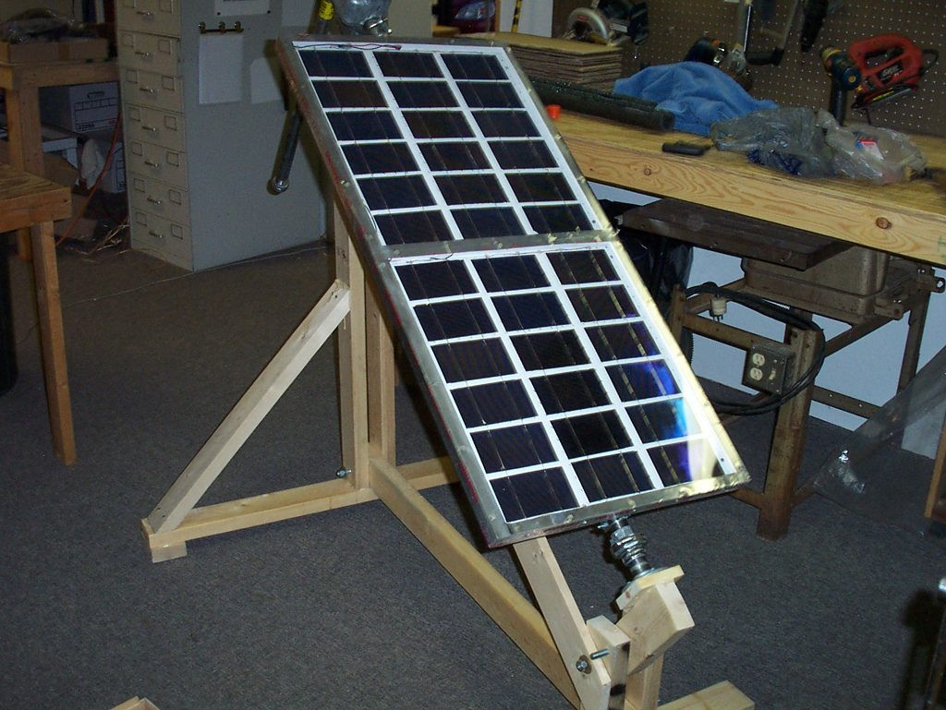
EN 2091 - ANALOG PROJECT
AUTOMATIC SOLAR TRACKER
BY TEAM SOCKET BURNERS

Slide 2
OVERVIEW
01
02
03
INTRODUCTION
Project objectives
system overview
04
05
06
key componenets
Future improvements
Task allocation

Slide 3


INTRODUCTION
*) Solar energy is a growing sustainable energy source, especially beneficial for countries near the equator like Sri Lanka.
*) The project focuses on improving photovoltaic (PV) system efficiency by designing a single-axis automatic solar tracker.
*)The tracker adjusts the solar panel’s angle to keep sunlight perpendicular for optimal energy generation.

Slide 4

PROJECT OBJECTIVES
01
Main Goal: Increase the efficiency of solar panels by ensuring they are always perpendicular to the sun's rays.
02
Control Mechanism: Implement a single-axis tracking system with an Analog PID Controller.
03
This system adjusts the solar panel’s position to capture maximum sunlight, improving energy generation.

Slide 5


SPECIFICATIONS
Supply voltage : +9V, -9V
Op Amps used: LN741, LM 358N
Slew rate:
Motor Driver: I293D
Motor used: RB0242
LDR used:
LDR light resistance: 100ohms
LDR dark resistance: 10kohms

Slide 6

BLOCK DIAGRAM
Sunlight
sensing
Error
Generation
PWM
generation
Motor
Control
Motor
Output
PID Controller

Slide 7
SYSTEM OVERVIEW
Sensors: Two Light Dependent Resistors (LDRs) detect sunlight intensity and generate error signals based on light differences.
PID Controller: Corrects the error by adjusting the position of the solar panels.
Proportional (P), Integral (I), and Derivative (D) components used for fine-tuning.
Motor Driver: Receives PWM signals generated by the PID controller to adjust the panel’s angle.

Slide 8
LDRs: Positioned to sense light intensity differences, generating voltage that indicates the sun's position.
SUNLIGHT SENSING MECHANISM
Differential Amplifier: Processes LDR signals to compute the difference in light intensity.
​
Error Signal: This difference is used to calculate the error signal, which is buffered and sent to the PID controller for processing.

Slide 9
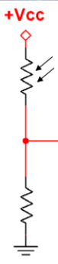
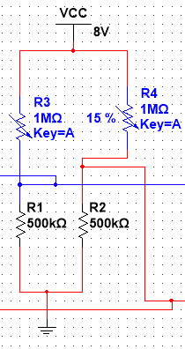
ERROR GENERATION
Voltage divider:
*) Consists of a Light Dependent Resistor and a fixed Resistor.
*) The Voltage difference is sent to an input buffer.
*) The solar tracker implementation consists of two such voltage dividers to keep track of the light intensity on either side of the panel.

Slide 10
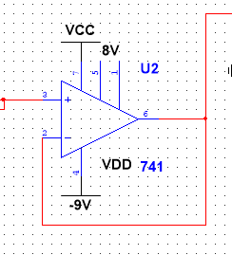
Input Buffers:
*) Each voltage divider input has an input buffer.
*) This minimizes the current drawn by the op-amps from the voltage divider circuit.
*) The outputs of the two buffers connected to each voltage divider are sent to the inputs of a differential amplifier.

Slide 11
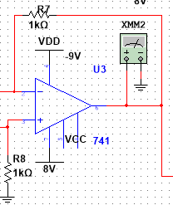
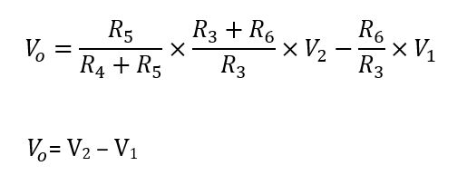
Differential amplifier:
*) This is used to amplify the difference between the inverting
and non-inverting inputs.
*) The resistors are chosen to be equal: Therefore, the output will be directly equal to the difference.

Slide 12

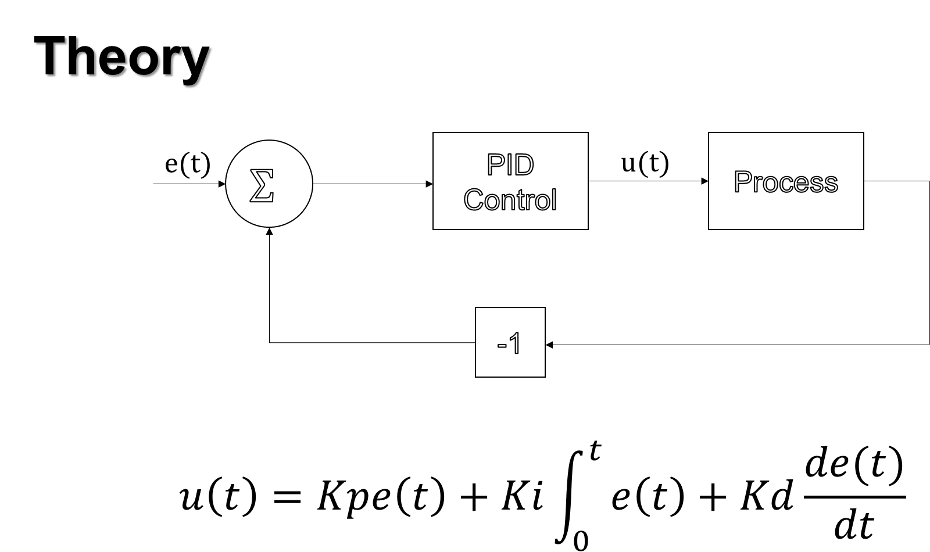
PID CONTROLLER IMPLEMENTATION

Slide 13
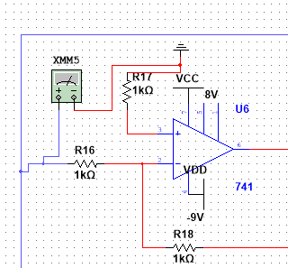

PID GENERATION
Proportional Controller :
*) This is the proportional part of the PID controller.
*)The proportional part of the circuit is implemented as an
inverting amplifier.
*) The resistors are chosen to make the gain equal to -1.

Slide 14
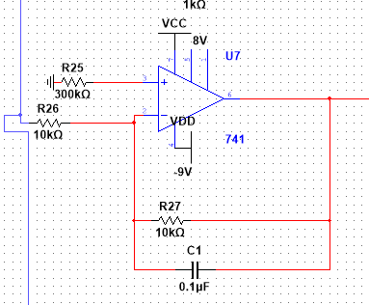
Integral Controller :
*) This is the Integral part of the PID controller.
*)This circuit is used to integrate the error signal.
*) Resistors are added in parallel to the capacitor to minimize any DC signal that can be integrated.

Slide 15
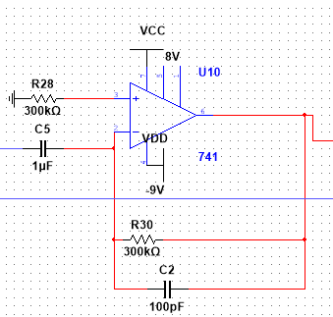

Derivative Controller :
*) This is the Derivative part of the PID controller.
*)This circuit is used to differentiate the error signal.
*) This can be used to control the output based on sudden
changes in the input.

Slide 16

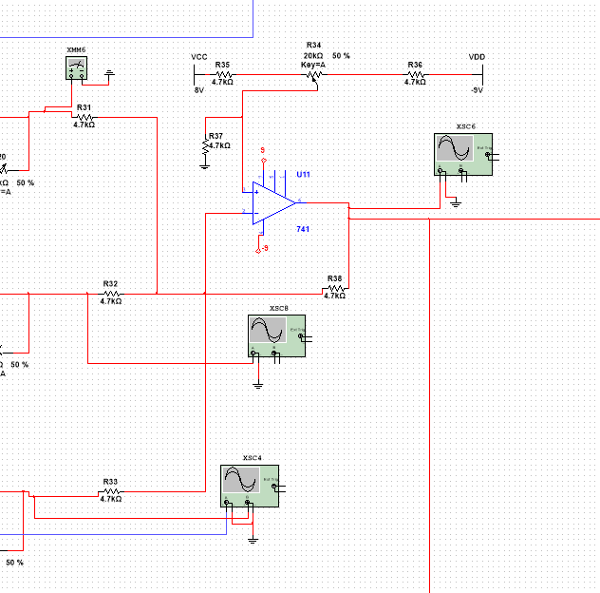

Weighted Adder:
A weighted adder is used to add the outputs of the P, I and D controllers.

Slide 17

PWM GENERATION FOR MOTOR CONTROL
Pulse Width Modulation (PWM): Used to control motor speed.
Signal Generation:
A triangular wave is produced by differentiating a square wave.
The triangular wave and PID output are rectified using precision rectifier circuits.
A comparator compares these signals, generating the required PWM duty cycle.
Motor Direction Control:
Two comparators check whether the PID output is positive or negative.
Based on this, transistors control the motor's direction.

Slide 18
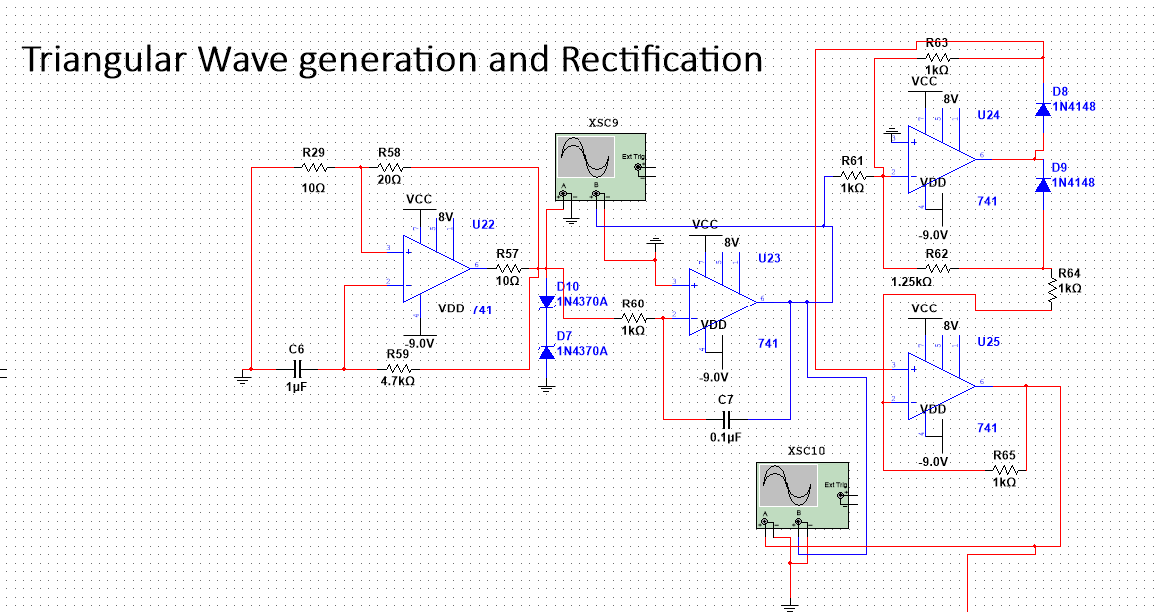
TRIANGULAR WAVE GENERATION
AND
RECTIFICATION

Slide 19
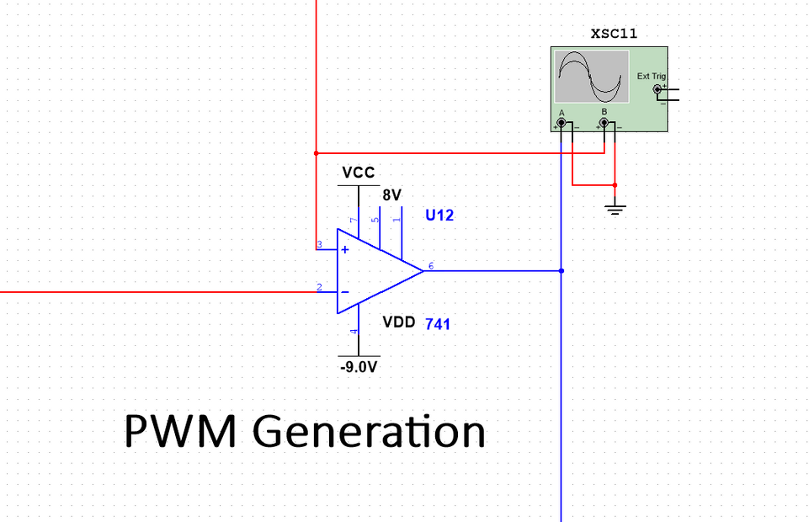

PWM GENERATION
*) The rectified triangle wave and rectified PID output signal are sent through a
comparator to generate a PWM signal of required duty cycle in order to control the motors

Slide 20
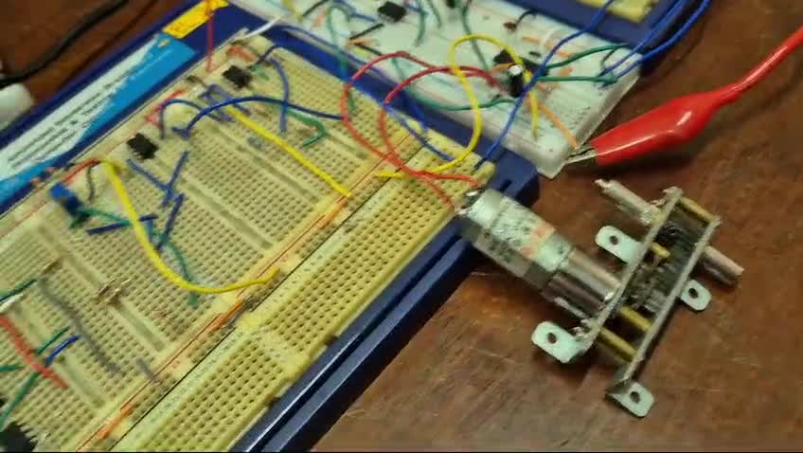
TESTING

Slide 21
THANK YOU!

